Slide 1
CHAP.18
WAVE MOTION

Slide 2
Mechanical Waves
Oscillation

Slide 3
Mechanical Waves

Slide 4
Mechanical Waves

Slide 5
Mechanical Waves

Slide 6
Mechanical Waves

Slide 7
Mechanical Waves

Slide 8
Mechanical Waves

Slide 9
Mechanical Waves
Wave motion

Slide 10
Mechanical Waves
Water wave
sound wave
light wave
light wave
electromagnetic wave
electromagnetic wave
Motion of particles

Slide 11
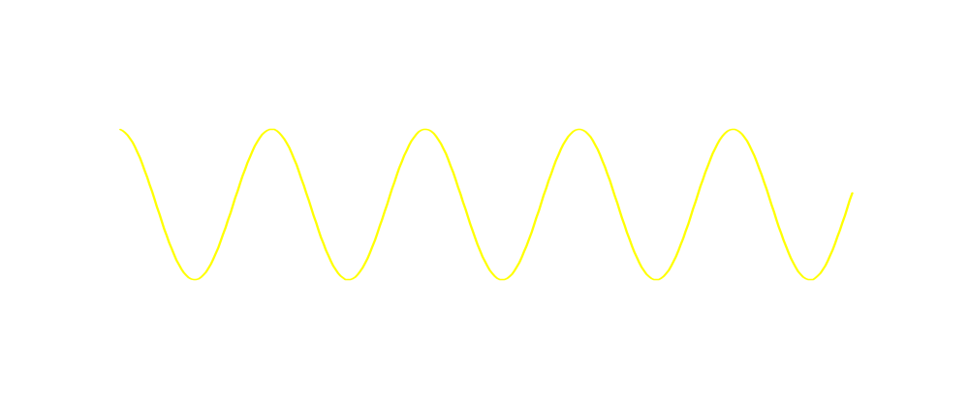
Mechanical Waves
Water wave
sound wave
y
transverse wave
x
Longitudinal wave
y
x

Slide 12
Mechanical Waves
Water wave
sound wave
Spherical wave
plane wave

Slide 13
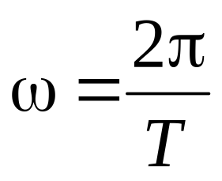
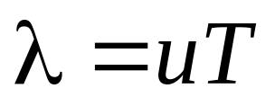
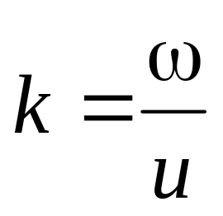
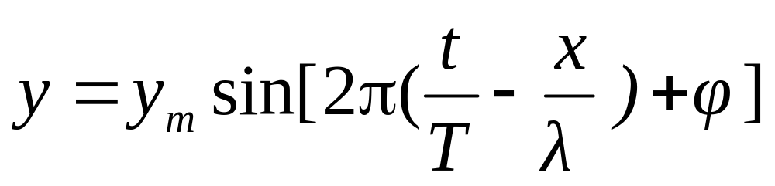
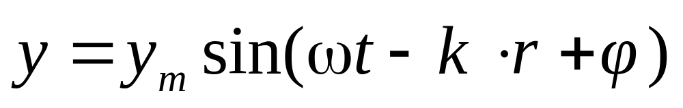
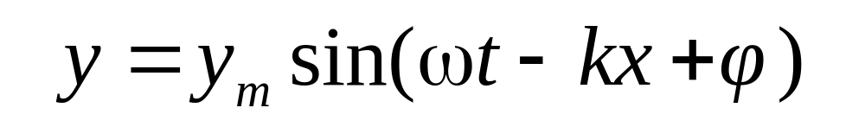
y
u
Wave speed
X
λ
Wave length
Simple Harmonic Oscillation
y = y_{m}sin(ωt +φ )
Plane Simple Harmonic Wave
y = y_{m}sin(ω ( t - x/u) +φ )
Wave vector
In 3-D

Slide 14
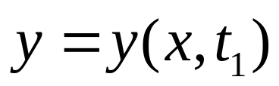
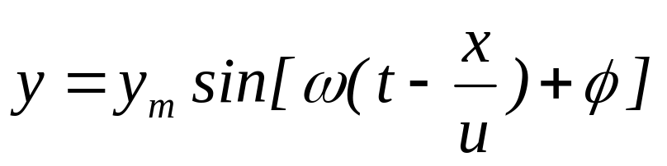
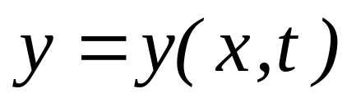
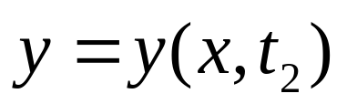
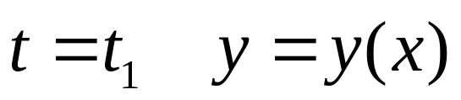
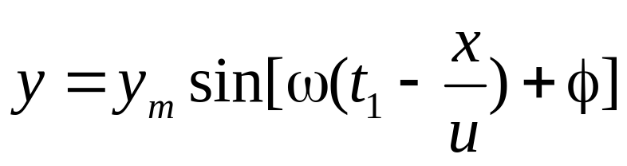
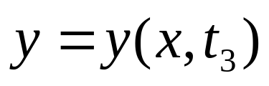
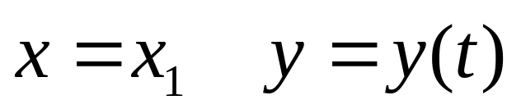
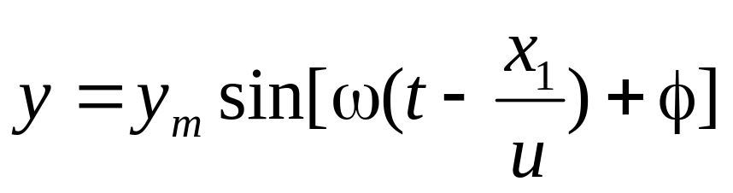
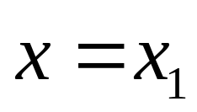
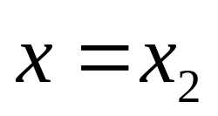
Plane Simple Harmonic Wave
Simple Harmonic Oscillation

Slide 15
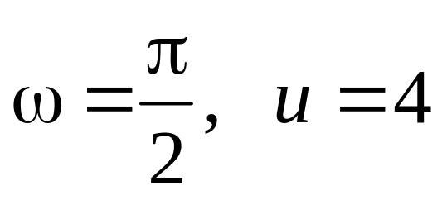
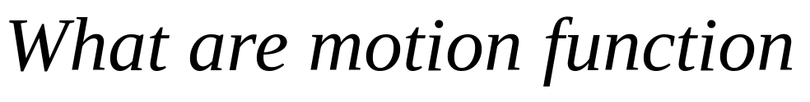
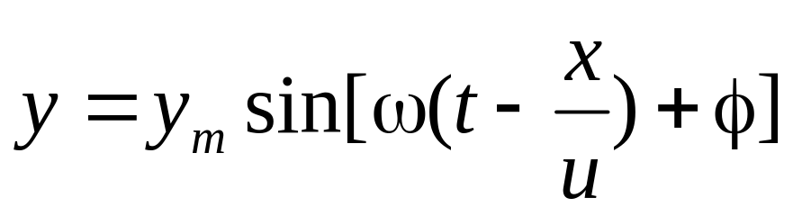
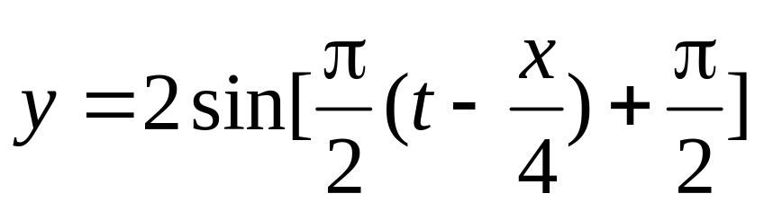
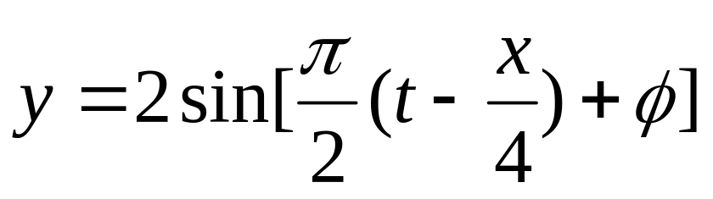
Example
y
u
X

Slide 16
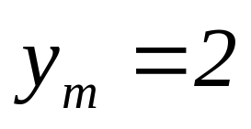
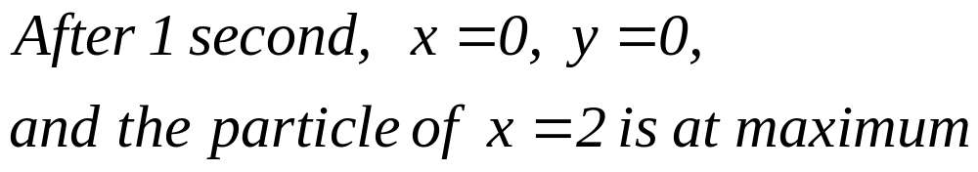
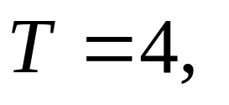
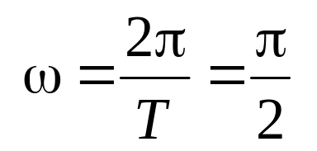
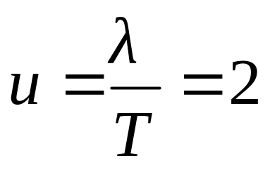
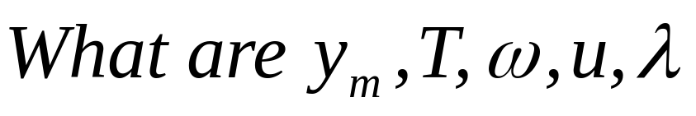
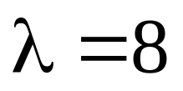
Example
y
u
X
λ

Slide 17
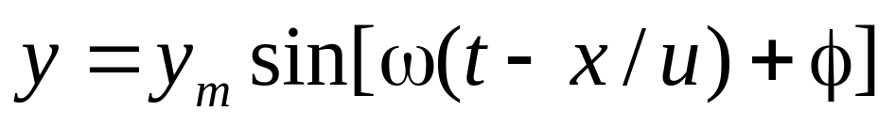
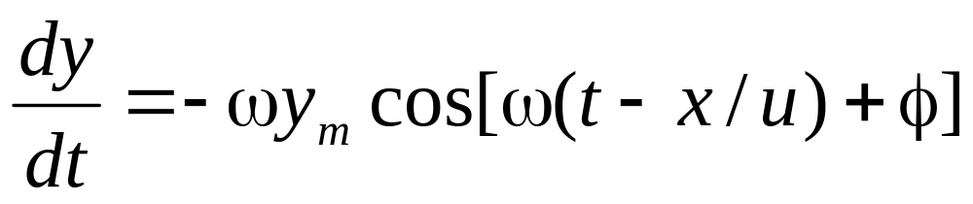
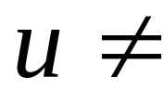
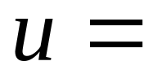
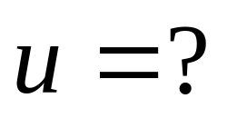
Wave Speed
y
u
Wave Speed
X
λ
Velocity of oscillation

Slide 18

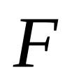
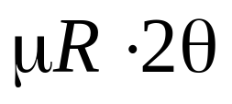


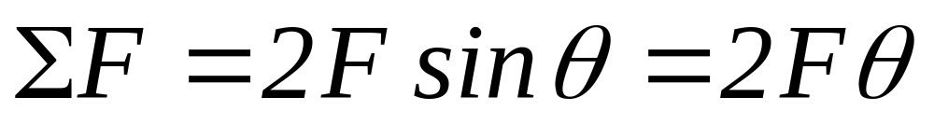
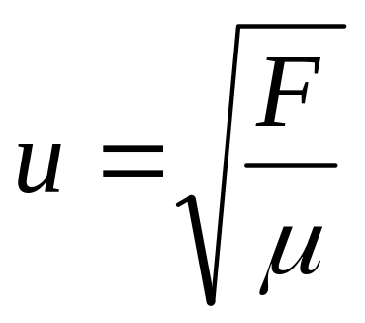
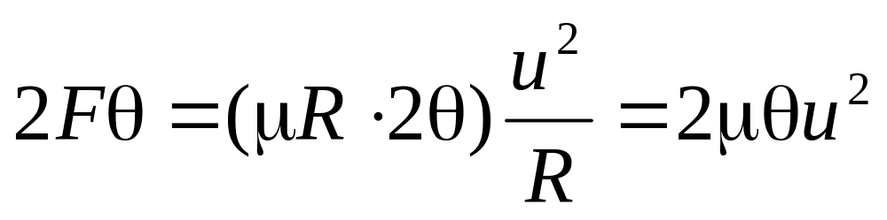
Wave Speed
String
y
u=?
X
y = y_{m}sin(ω ( t - x/u) +φ )

Slide 19
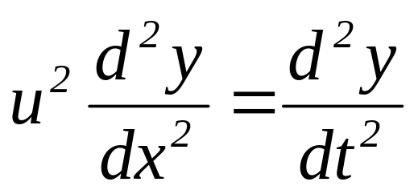
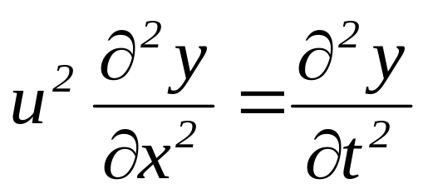


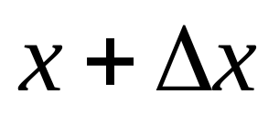
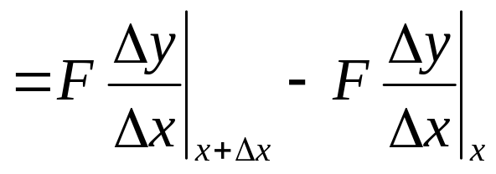
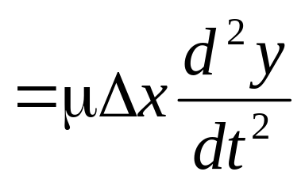
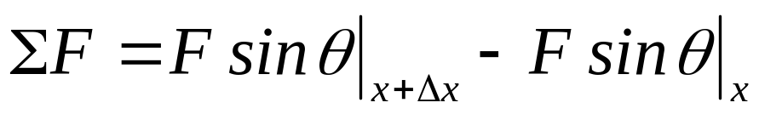
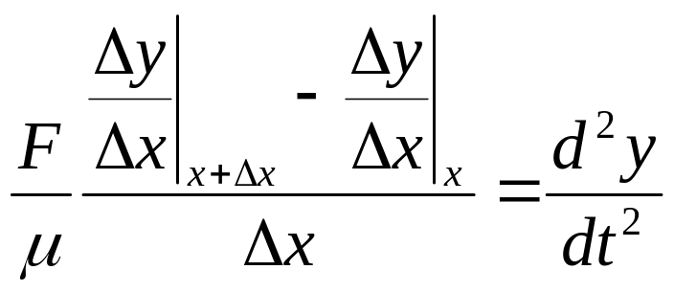
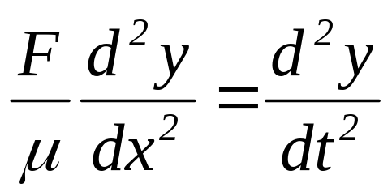

Wave Speed
y
X
Plane Simple Harmonic Wave

Slide 20
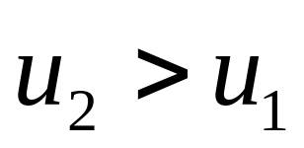
μ₁> μ₂

Slide 21
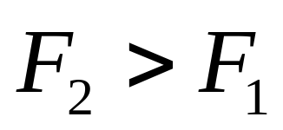

Slide 22












Δy
Wave Speed
Δx
A
x
x+ Δx
string

Slide 23












Δy
Wave Energy
Δx
A
Kinetic Energy
x
x+ Δx
Potential Energy

Slide 24


y
u
X
λ

Slide 25


y
u
X
λ

Slide 26


y
u
X
λ

Slide 27
CHAP. 18 Exercises
P421 2, 4, 7
P422 11, 12

Slide 28



Plane Simple Harmonic Wave
Wave Function
Wave Speed
Wave Energy

Slide 29







Δy
u
Wave Energy
1
E
Δx
A
x
x+ Δx
Power
Average of energy
Intensity

Slide 30


Δy
u
Wave Energy
1
E
Δx
A
x
x+ Δx
Power
plane wave
Intensity
Spherical wave

Slide 31








s₁
interference
x₁
p
At p point
x₂
s₂
x₁ - x₂ = n λ Max
x₁ - x₂ = (n+1/2) λ min

Slide 32








Standing Wave
y
u
u
X

Slide 33




Standing Wave
Δx
y
E
E
X
λ

Slide 34



Reflection
u
u

Slide 35











u
u
Example
Reflection Wave

Slide 36



u
u
u
Example
Hard reflection
phase delay
Reflection Wave

Slide 37






Wave Function
Reflection Wave
Hard reflection
phase delay
Soft reflection
path delay
No phase delay

Slide 38

Resonance
Amplitude reduces

Slide 39

Resonance
Amplitude does not reduce

Slide 40

Resonance

Slide 41

Resonance

Slide 42

Resonance

Slide 43




Resonance

Slide 44





Resonance

Slide 45



Resonance

Slide 46







Resonance

Slide 47
Plane Simple Harmonic Wave
y
X
y = y_{m}sin(ω ( t - x/u) +φ )

Slide 48


Plane Simple Harmonic Wave
y
Non PSH Wave
x

Slide 49
Plane Simple Harmonic Wave
y
Non PSH Wave
X

Slide 50









Example

Slide 51












Example

Slide 52












Example
Path delay

Slide 53
CHAP. 18
Exercises P423 27, 32
Problems P424 13, 14, 15

